Slide 1

LegalSeg: Unlocking Indian Legal Judgments
Presented By:
Team - G618
A Praneeth Sai
P Sai Yashwanth
Ch Prateek
P Chrysolite
B Vamshi Krishna
Guide : Mrs. G Keerthi
Transforming legal document understanding through AI-powered rhetorical role classification with the largest annotated dataset of its kind.

Slide 2
Paper and Project Overview
The Challenge
Key Innovation
Legal documents are complex and unstructured. Understanding their semantic organization is crucial for legal research, case analysis, and automated decision-making systems.
We introduce the largest annotated dataset for Indian legal judgments, benchmarking multiple state-of-the-art models including transformers, GNNs, and instruction-tuned LLMs.
This work sets a foundation for future legal NLP research and practical applications.
Solution: LegalSeg dataset with 7,120 documents and 1.4M sentences, enabling advanced AI models to segment legal texts into 7 rhetorical roles.

Slide 3

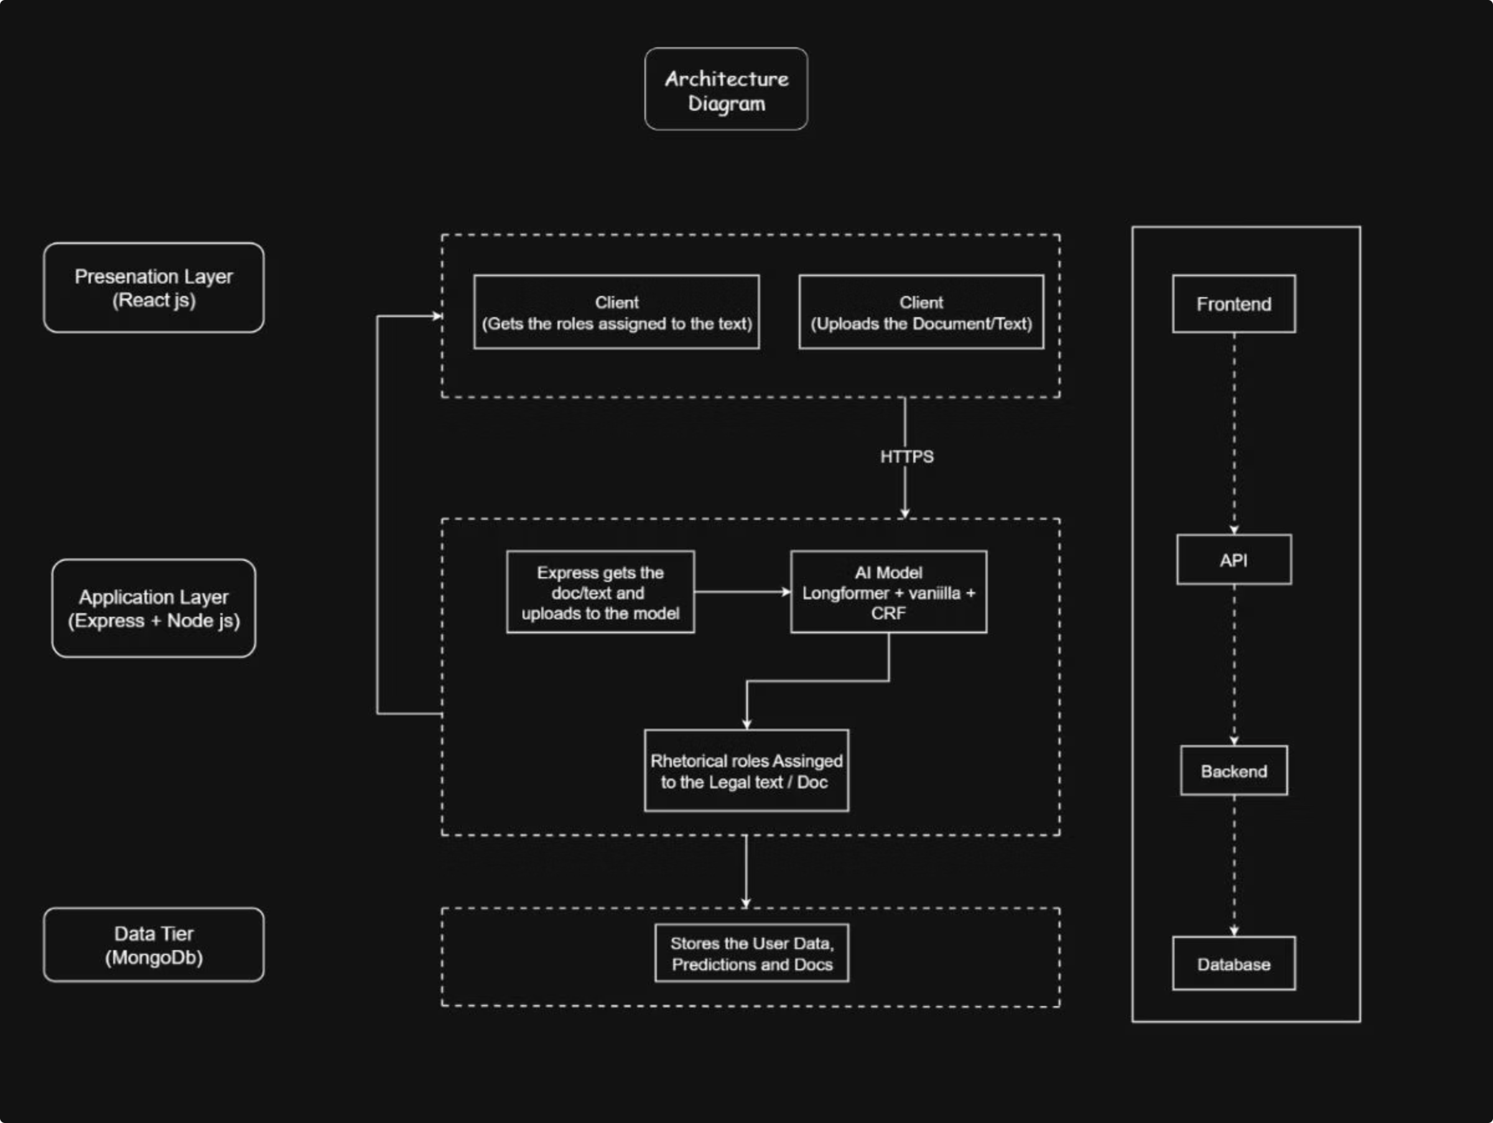
System Architecture

Slide 4








Technology Stack & Tools
Python
Google Colab & VS Code
React-js
Google Colab for intensive model training with GPU acceleration. VS Code for web application development.
Node-js
Express-js
MongoDB
Deployment Platforms
NoSQL database solution for storing legal documents, annotations, and model predictions efficiently.
Hugging Face for model evaluation and sharing. GitHub for version control and source code repository management.

Slide 5

Mathematical Foundation
Core Task Definition
Multi-Task Learning Loss
The goal is semantic segmentation by assigning rhetorical role labels to each sentence in legal documents.
MTL framework combines label shift prediction with role classification:
where Si is a sequence of sentences and Y is the set of 7 rhetorical roles.
where λ balances the two tasks, enabling better sequential dependency learning.
Rhetorical Roles
For each sentence sij, we find:

Slide 6
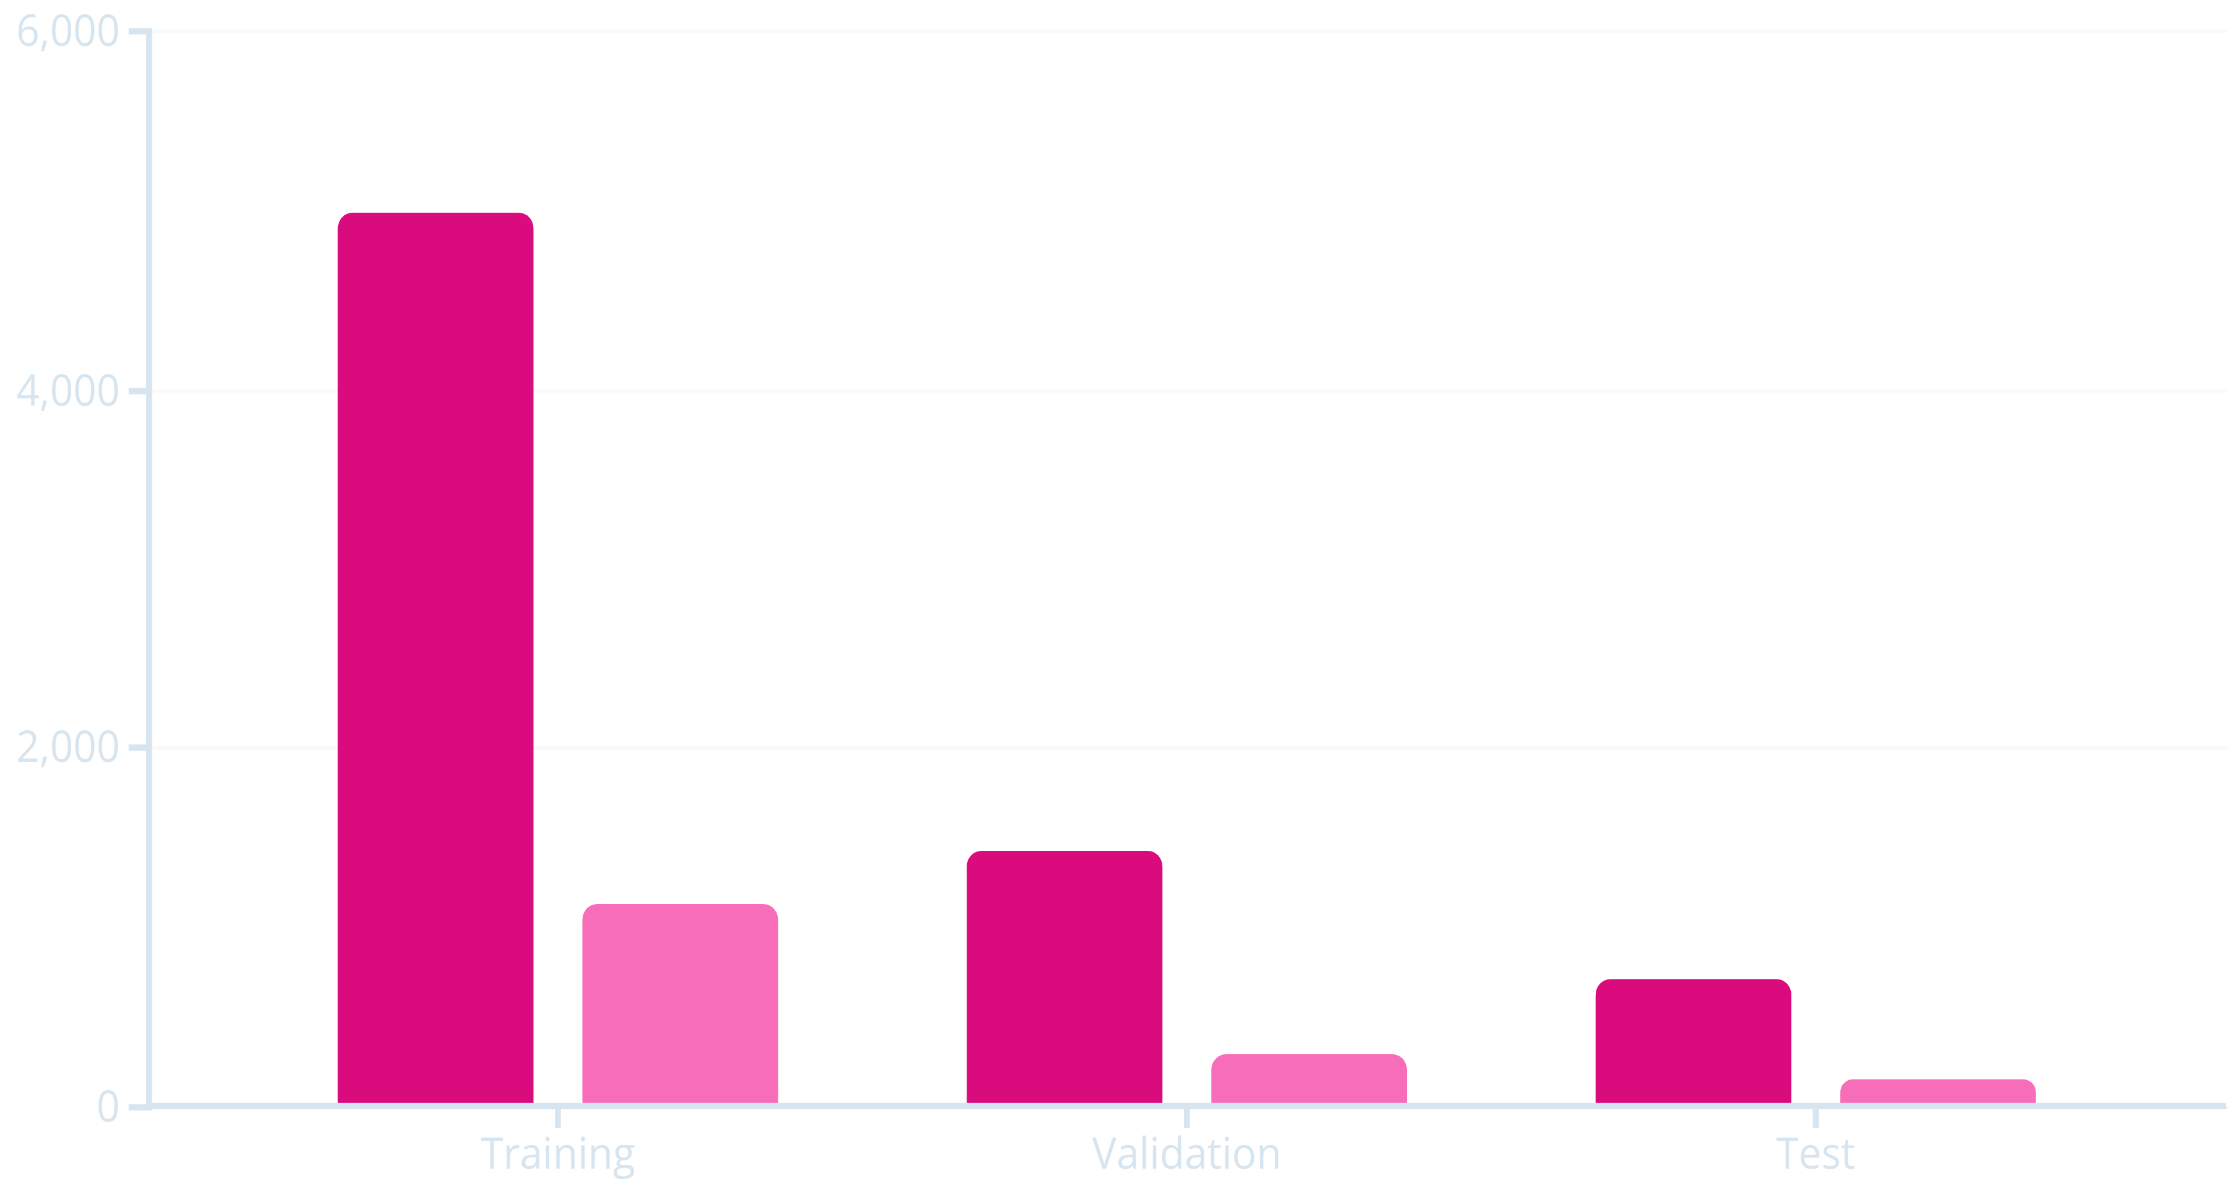
Dataset Statistics
Documents
Sentences (thousands)
7,120
1.4M
7
Total Documents
Annotated Sentences
Rhetorical Roles
Largest annotated legal dataset for rhetorical role classification
Comprehensive coverage across Supreme Court and High Courts
Facts, Issue, Arguments (Petitioner & Respondent), Reasoning, Decision, None

Slide 7
Live Implementation Demo

Slide 8
Results & Key Learnings
Model Performance
Improvements & Extensions
Legal-Long former achieved 42% F1-Score and 40% Precision, outperforming transformer-based approaches.
Our implementation introduced novel approaches including Legallongformer with global context using transformer and CRF layer.
Key Insight: Sequential modeling with CRF layers captures label transitions better than independent sentence classification.
Real-World Applications:
Challenges Overcome
Automated legal rhetorical role classification
Enhanced legal search and insights
Class imbalance with overrepresented "None" and "Facts" labels
Support for legal decision-making workflows
Confusion Between AOR and AOP
Limitations
Computational constraints for large language models
Model training couldn’t be at most precise as we had computational dependencies for training large datasets and epochs.

